Slide 1
Next Class Presentation
(8 Nov 2020)

Slide 2
STATE YOUR CHALLENGE
How can small businesses reach more people ?
How to increase income for small entrepreneurs?
How to improve sales management to be more efficient?
How can buyer find the food the they wanted more easily?

Slide 3
TEAM KNOWLEDGE & ASSUMPTIONS
What are the aspects of the challenge that you already know a lot about? What are your assumptions?
#1 The user has smartphone and internet connection.
#2 The seller has their own vehicle to do cash on delivery.
#3 The user has already know some basic knowledge on how to use the application.
#4 The buyer is ready to spend their money when using the application.
#5 The seller is gaining their income through the application.

Slide 4
RESEARCH PLAN
Community members to visit
Small entrepreneur who doesn’t have shop or offices who are working from home.

Slide 5
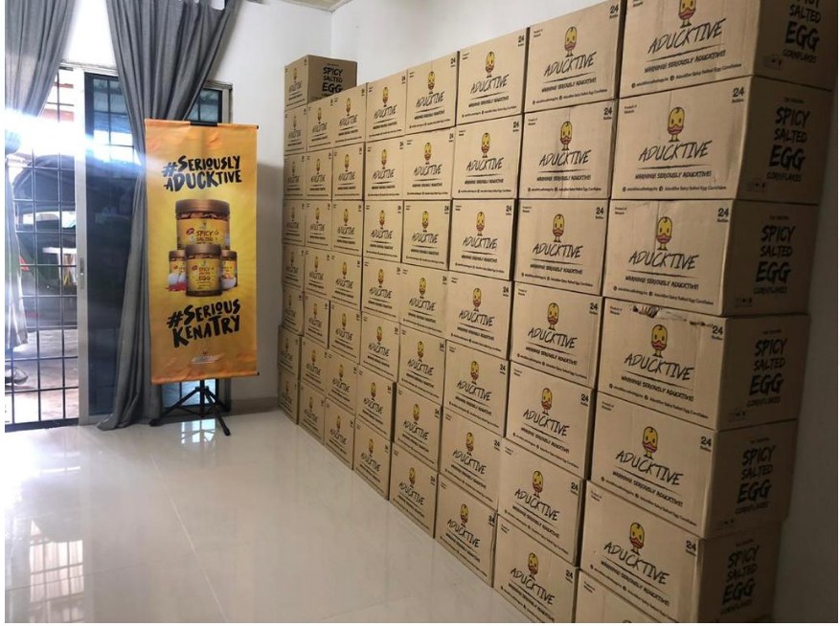
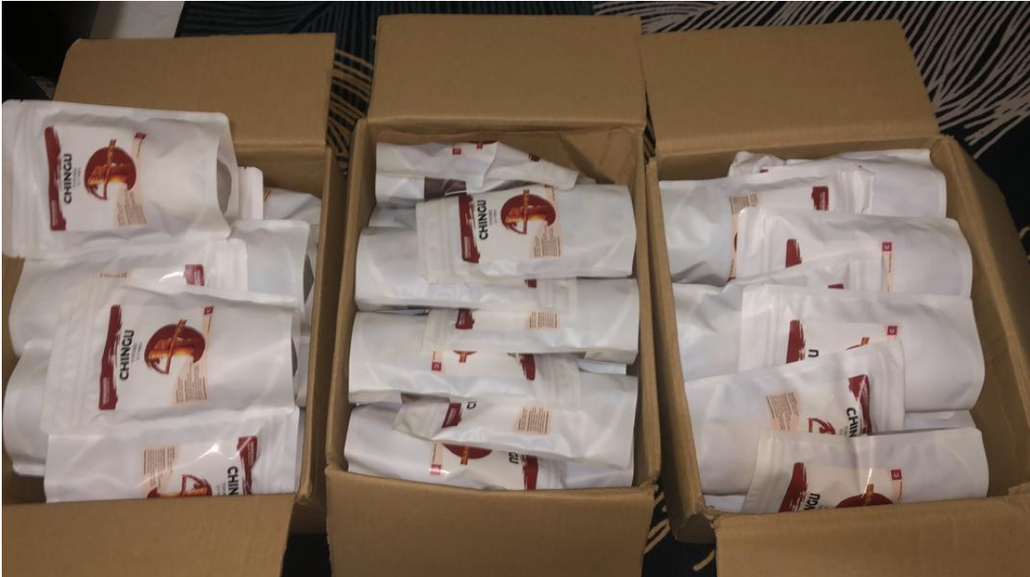
^{Experts to Speak To}
Aductive Spicy Salty Egg Cornflake supplier

Slide 6
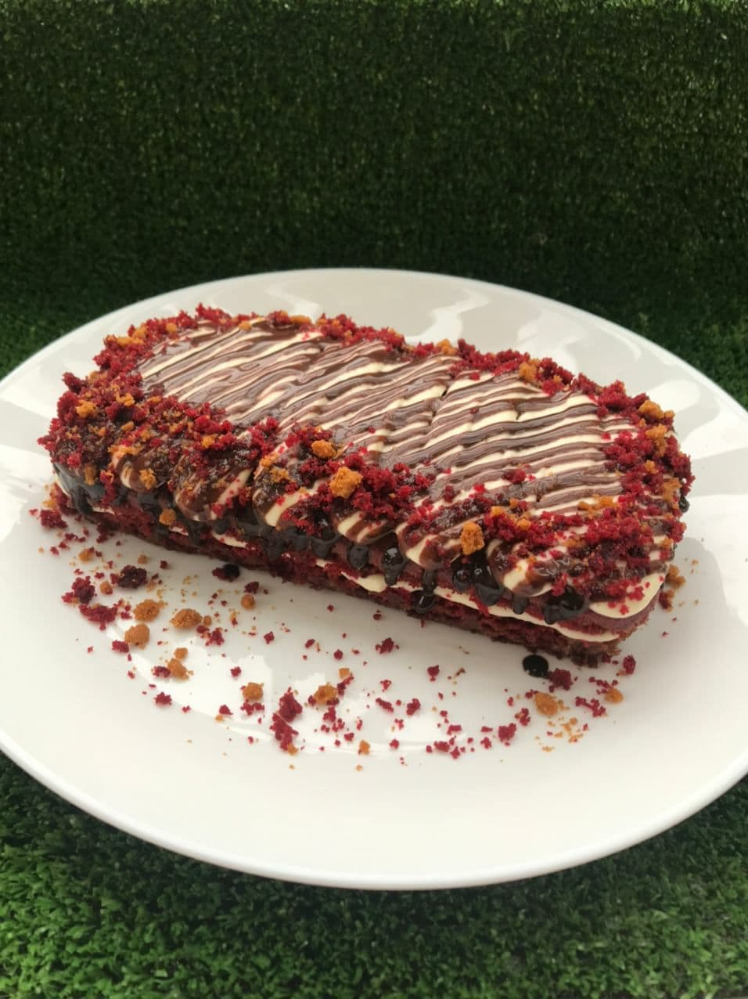
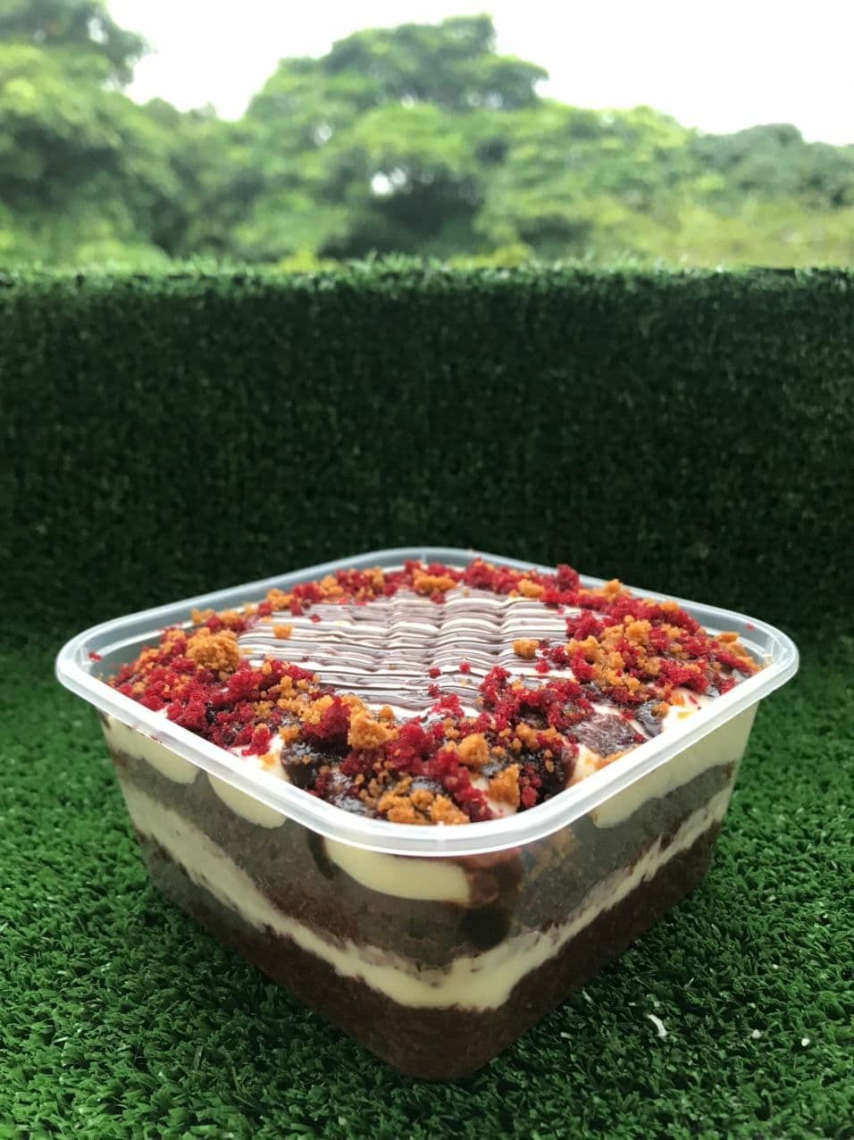
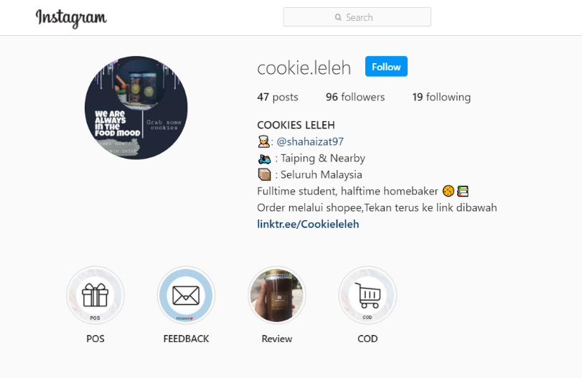
^{In-Context Immersion Locations}
They made this cake from their own house (homemade)

Slide 7
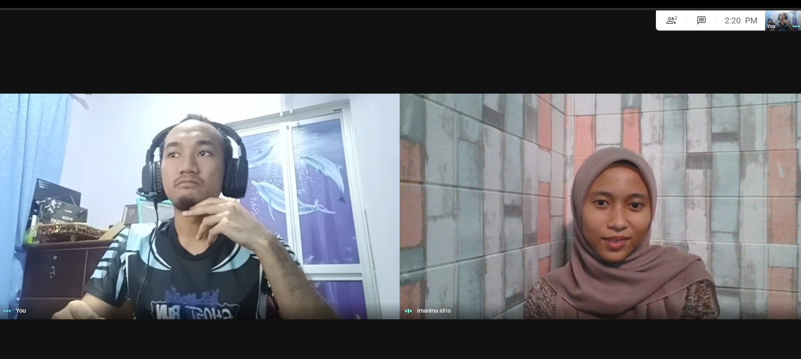
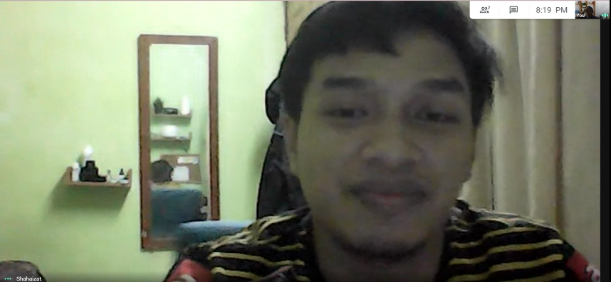
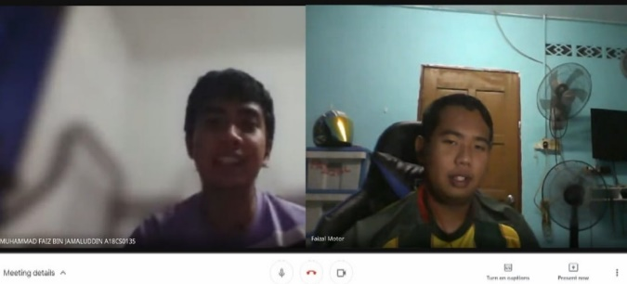
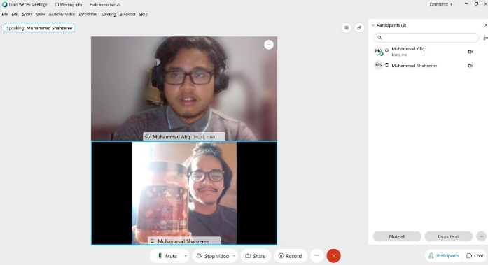
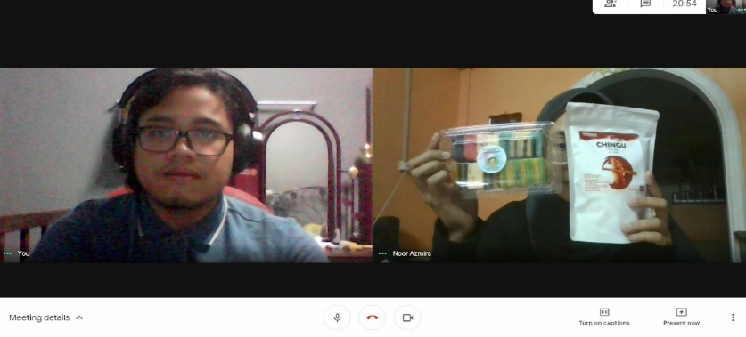
^{Analogous Research Locations}

Slide 8
BUILD A QUESTION GUIDE
Ask how they are doing then introduce themselves
Their business background, how it started and how currently is.
How they do their promotion, how do they track their order
How many average order per day
What are the challenges that they faced through their business?
Ask their knowledge about the current available food delivery apps and what is their thought about that apps.
What are their hopes, dreams about future entrepreneur?
Any thought of having apps for them? Explain about our planned apps and ask their opinion whether it will be helpful or not

Slide 9
CONDUCT YOUR RESEARCH
Result of Interview Session
Result of Observation of the people at the location
Sketch your Empathy and Sympathy
Note & Photo of your observation

Slide 10
1. RESULT OF INTERVIEW SESSION
1. How do you promote your product?
Through social media such as IG stories , whatsapp groups and others, every weekend.
2. How many average customer per day?
Minimum 5 and the highest recorded order is 30 orders
3. How do you do order tracking?
Everytime we get new order, we update in whatsapp group with my business partner
4. Any challenges or problems occur ?
Usually forgot and lost track of material, just realise the day we made the cake

Slide 11
1. RESULT OF INTERVIEW SESSION
5. Do you think that food4u should be developed?
The application is needed for small business entrepreneur to promote their business even further
6. What are the features would you like to have in the application?
- Have the application to be specificly focus on food only
- Provide free delivery coupon when A certain amount of price of food is reached
- Differentiate the food according to categories
- Provide both cash on delivery and postage
- Set the food provided according to certain area
- Have the search function to find the food
- Have various kind of food in the application

Slide 12
2. RESULT OF OBSERVATION OF THE PEOPLE AT THE LOCATION

Slide 13


2. RESULT OF OBSERVATION OF THE PEOPLE AT THE LOCATION

Slide 14
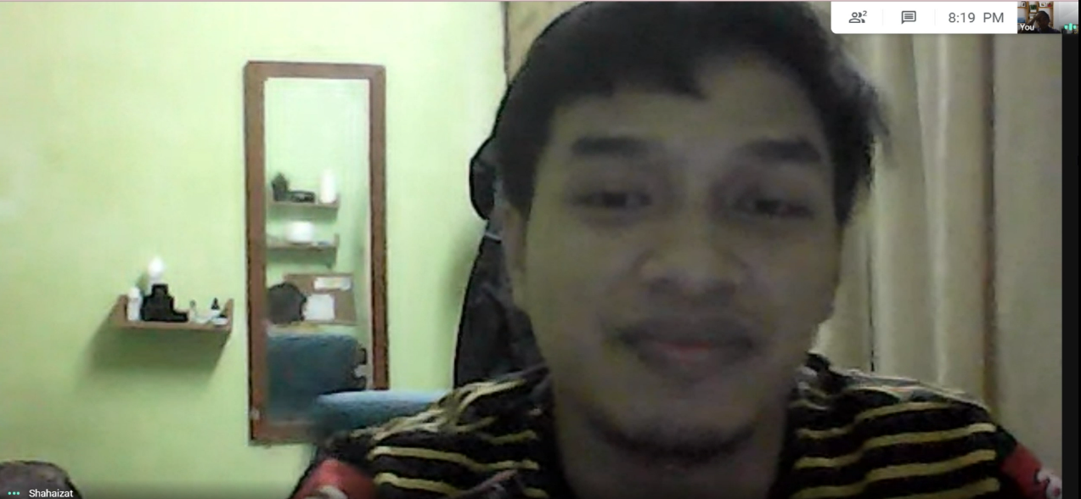

2. RESULT OF OBSERVATION OF THE PEOPLE AT THE LOCATION

Slide 15
3. SKETCH YOUR EMPATHY AND SYMPATHY
Empathy : If we conduct this project, we can provide a platform to improve the efficiency of their buying and selling process.
Sympathy: We need to conduct this project to improve their efficiency in buying and selling process

Slide 16
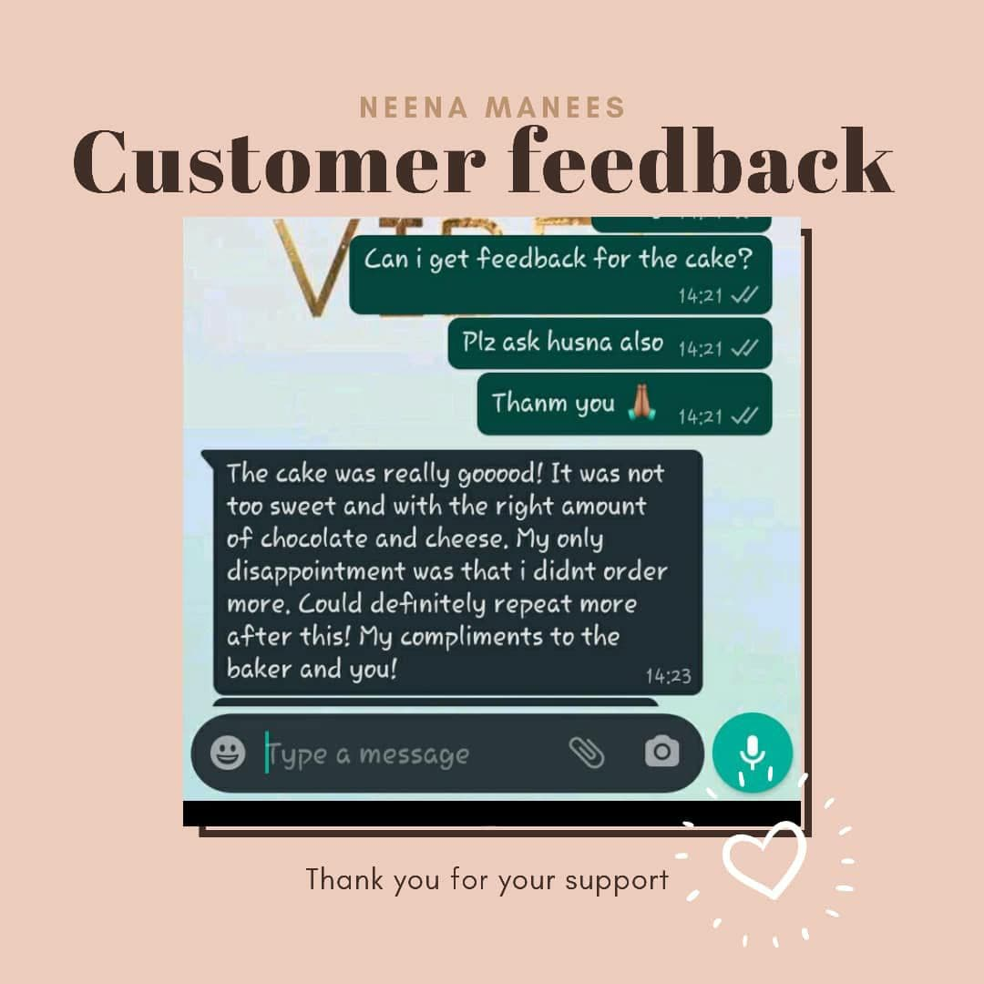
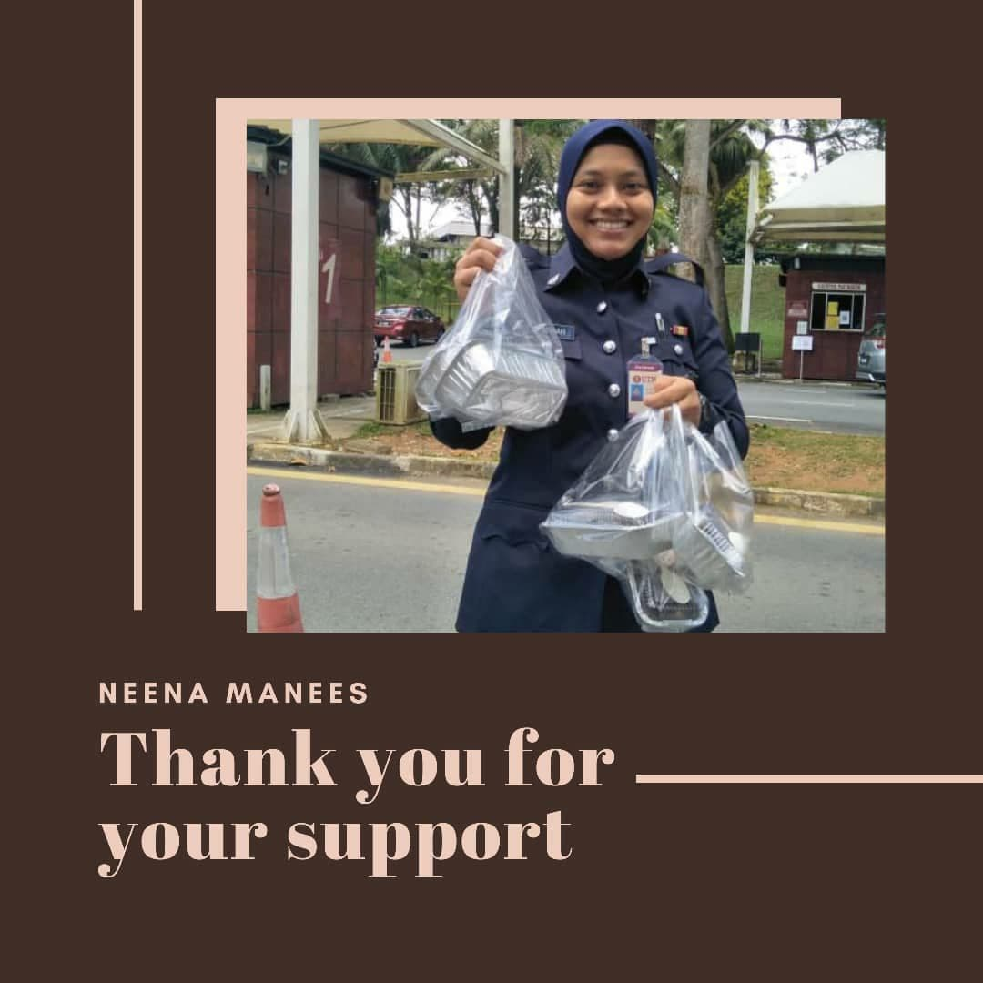
4. NOTE & PHOTO OF YOUR OBSERVATION

Slide 17
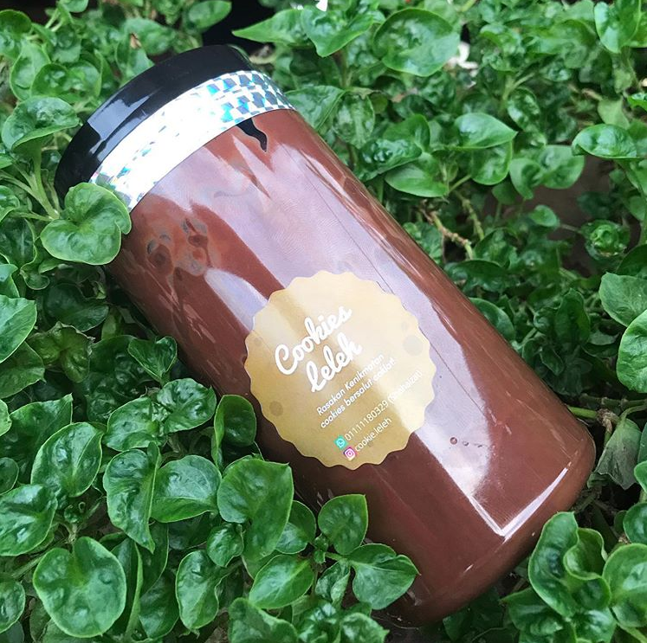
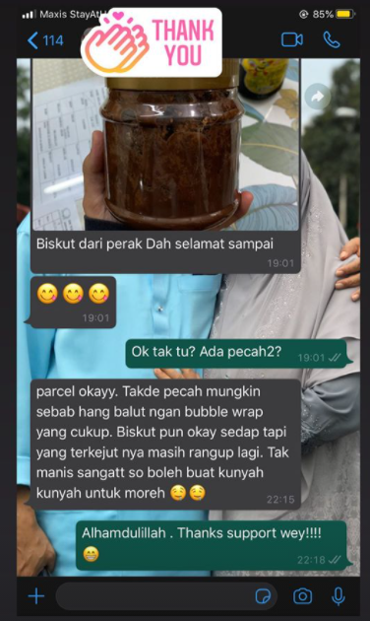
4. NOTE & PHOTO OF YOUR OBSERVATION

Slide 18
WRITE YOUR DISCOVERY REPORT
Based on the observation, all of the sellers that we interviewed support our initiative to create an application to help them promote their products. Most of them want a feature to categorize their product accordingly. They also want the application to have search function to find specific product and to find the location that is available for each product in their area.
As for the payment method, majority of them prefer to have Cash-On-Delivery(COD), Online Banking and Credit/Debit Card. Some of them want postage and self-pickup method.
As for the buyers, we have prepared online surveys for them. Most of them use food delivery apps and want the application to be user-friendly.

